Slide 1

HOME CREDIT DEFAULT RISK
By – Raghavi Dube
- Sai SHANMUKHA BHARADWAJ
PALAKODETI

Slide 2
OBJECTIVE
In this project, we classify loan applicants into two groups based on home credit loan defaulters dataset:
(a) applicants for home loans who repay the loan
(b) applicants who default on the loan.
The second phase of our project involves applying various classification models to the dataset and conducting a comparative analysis to determine the most effective and precise algorithm to use.
Based on the candidate's likelihood of repaying the loan, this analysis aids the lending institutions in making decisions about whether to approve or deny loan applications in order to prevent unnecessary losses.

Slide 3
DATA DESCRIPTION
Based on data such as clients' prior credits by other financial institutions reported to credit bureaus, applicants' repayment history, and more, the HOME CREDIT DEFAULT RISK dataset is used to classify loan applicants as reliable loan takers or loan defaulters.
We have acquired our dataset from Kaggle. Here is the link to the dataset –
https://www.kaggle.com/competitions/home-credit-default-risk/data

Slide 4
7 distinct files make up our dataset. While 7 files are used for data exploration and visualization, only 1 file is used for the classification model. The data files are –
CREDIT_CARD_BALANCE - This dataset contains snapshots of the applicant's previous Home Credit cards' monthly balances. Each month's history of each prior Home Credit (consumer credit and cash loan) related loan in our sample is represented in this table by one row.
PREVIOUS APPLICATION - All previous applications for Home Credit loans of clients who have loans in our sample are in this dataset. There is one row for each previous application related to loans in our data sample.
INSTALLMENTS PAYMENTS - This dataset provides information on the Home Credit loans in our sample's repayment history for previously granted credits. Each row represents a completed payment, and each row represents a missed payment. In our sample, one row corresponds to one installment payment, one installment payment of a previous Home Credit financing loan, or both.
POS_CAS_BALANCE - This dataset contains monthly balance snapshots for cash loans and POS (point of sale) loans the applicant previously had with Home Credit. Each month's history of each prior Home Credit (consumer credit and cash loan) related loan in our sample is represented in this table by one row.
BUREAU - For clients who have loans in our sample, this dataset incorporates information about all prior credits that the client has received from other financial institutions and that have been reported to the credit bureau.
f) APPLICATION – Our classification models use this dataset. All applications' static data is contained in this file. In our data sample, each row corresponds to a single loan.
g) BUREAU_BALANCE - This dataset includes monthly credit balances from the Credit Bureau. Each month of the history of every prior credit report to a credit bureau is represented by a row in this table.

Slide 5
VARIABLES
There are about 200 different variables in our dataset. These 200 features include three different datatypes, including strings, float values, and integers.
Categorical columns were also included in the dataset. Using labelencoder() from sklearn, we converted these categorical values to numerical attributes.
We used all of the variables after understanding and pre-processing them all because the classification model needed them all to learn.

Slide 6
STEPS FOLLOWED
Data collection and interpretation
Data cleaning and pre-processing
Data visualization
Feature selection
Multiple Model Implementation
Measuring model performance for all the models
Selecting the best model
Final implementation of the model

Slide 7
DATA PRE-PROCESSING
Data pre-processing included –
The entire dataset was divided into training and validation data. The training data consisted of 122 columns and 307511 rows.
With the help of info(), we observed the data types of each attribute throughout the dataset along with their corresponding null values.
Null values were identified using isnull() for each columns and then handled by imputing the column mean.
Used describe() to check all the statistical properties of the given dataset i.e mean, median, 25th, 50th, 75th, min, and max values.
Checked the correlation between each attribute to determine which ones to feed into the model as input.

Slide 8
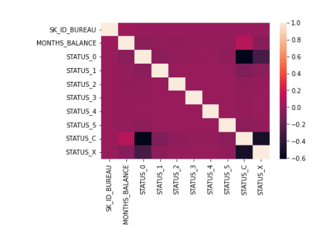
EXPLORATORY DATA ANALYSIS
HEATMAP – Using a heatmap, we analysed correlation between the variables to reduce redundancy and drop highly correlated variables, preventing the risk of model overfitting.

Slide 9
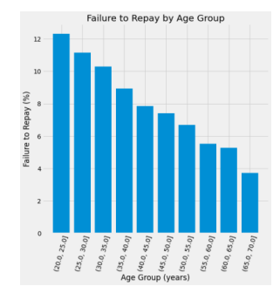
We generated a bar graph to visualize the relationship between FAILED REPAYMENTS and AGE variables. We can infer from this plot that the age range of 20 to 25 years has the highest percentage of home loan defaulters, whereas the age range of 65 to 70 years has the highest percentage of repayments.

Slide 10
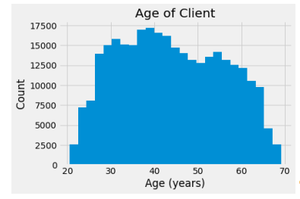
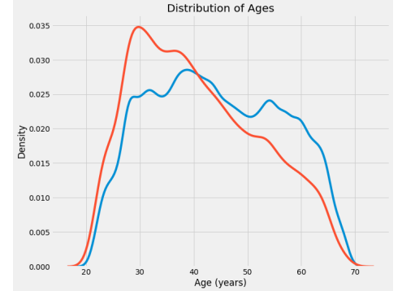
To understand the client age group of the provided data, we plot a histogram. The most clients, according to this histogram, are between the ages of 35 and 45, while those between the ages of 20 and 23 and 67 and 70 received the fewest home loans.
To further understand the age distribution of clients, we plot a distribution plot.

Slide 11
MODELS
The different models evaluated for their performance on the HOUSE CREDIT DEFAULT RISK are –
Logistic Regression Model
Decision Tree
Random Forest
K-Nearest Neighbours
Naïve Bayes Model

Slide 12
MODEL 1 – LOGISTIC REGRESSION
A classification algorithm called logistic regression is used to determine the likelihood that an event will succeed or fail. When the dependent variable is binary (True/False, Yes/No, 0/1, etc.), it is used. By analyzing the relationship from a given set of labelled data, it supports classifying data into distinct classes. From the provided dataset, it learns a linear relationship before introducing a non-linearity in the form of the Sigmoid function.
ADVANTAGE – Easier to implement, efficient to train, less inclined towards over-fitting, computationally fast and cheaper.
DISADVANTAGE – Only used for linear problems, sensitive towards outliers, does not supports multicollinearity between independent variables.
IMPLEMENTATION – Our logistic regression model on house credit default risk dataset worked with an accuracy of 91.98%.

Slide 13
PERFORMANCE EVALUATION: LOGISTIC REGRESSION
ACCURACY - The logistic regression model's accuracy was 91.98%, meaning that for 91.98% of the observations in the validation set, it correctly predicted the outcome of the target variable.
PRECISION - It is the proportion of true positive predictions to the total number of positive predictions. In other words, precision measures the percentage of times that the model correctly identifies the positive cases out of all the times it predicts positive. The precision of the logistic regression model was 0.92.
RECALL - It is the ratio of correctly predicted positive outcomes to all actual positive cases. Recall quantifies the proportion of real positive cases that the model correctly recognizes. The logistic regression model's recall was 1. Thus, the model correctly predicted that every positive was a true positive.
F1 SCORE - F1 score is a commonly used metric in classification models, which combines precision and recall into a single score. It is the harmonic mean of precision and recall, and is therefore a useful measure for balancing these two metrics. The F1 Score of the logistic regression model was 0.96.

Slide 14
MODEL 2 – DECISION TREE
A decision tree is a particular kind of tree structure that resembles a flowchart, where each internal node represents a test on an attribute, each branch a test result, and each leaf node (terminal node) a class label.
ADVANTAGE – Impact of null/missing values is insignificant, helps to understand which fields are most important for prediction and classification, helps to perform classification without requiring much computation.
DISADVANTAGE – Highly sensitive towards data changes, involves higher time to train the model, inadequate for applying regression and predicting continuous values.
IMPLEMENTATION – Decision tree algorithm has an accuracy of 85.33% with our dataset.

Slide 15
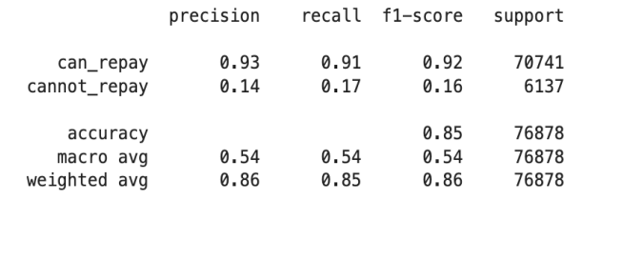
PERFORMANCE EVALUATION: DECISION TREE
ACCURACY - The observed accuracy for the training data using decision tree is 85.3%
The precision, recall and F1-score are –

Slide 16
MODEL 3 – RANDOM FOREST
In order to perform classification, regression, and other tasks, the random forest ensemble learning method builds a large number of decision trees during the training phase. The class that the majority of the trees chose is the output of the random forest for classification tasks. The mean or average prediction of each individual tree is returned for regression tasks.
ADVANTAGE – reduces overfitting and increases accuracy in decision tress, flexible for classification as well as regression, automates missing values.
DISADVANTAGE - requires high computational power, it suffers interpretability and fails to determine the significance of each variable.
INTERPRETATION – The accuracy of random forest algorithm is 92.01%.

Slide 17
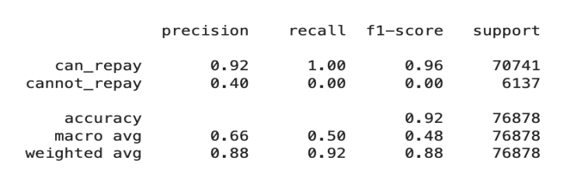
PERFORMANCE EVALUATION- RANDOM FOREST
ACCURACY - The observed accuracy for the training data using random forest algorithm is 92.01%
The precision, recall and F1-score are –

Slide 18
MODEL 4 – K- NEAREST NEIGHBOR
The KNN algorithm involves finding the K datapoints that are closest to the starting point in terms of distance. By combining the target values of the closest neighbors, it can be applied to classification or regression in order to make a prediction.
ADVANTAGE – Easy to implement with no parametric assumptions, new data can be added without disrupting the model's accuracy because training is not necessary.
DISADVANTAGE – Highly sensitive to outliers and large datasets, assumes equal importance to all variables.
IMPLEMENTATION - k-NN classifier was run over 5(k=5) and 1(k=1) iterations. An accuracy of 85.85% was achieved with k=1 and 91.56% with k =5. Since k=5 shows a higher accuracy, it is the selected k value.

Slide 19
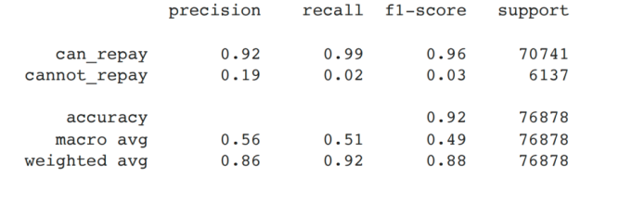
PERFORMANCE EVALUATION- K-NEAREST NEIGHBORS
An accuracy of 91.56% was achieved with k = 5, whereas an accuracy of 85.85% was achieved with k = 1. For further development, we use k=5.
The precision, recall and F1-score are –

Slide 20
MODEL 5 - NAÏVE BAYES MODEL
A naive Bayes classifier is an algorithm that categorizes objects using Bayes' theorem. Strong or naive independence between the attributes of data points is an assumption made by naive Bayes classifiers.
ADVANTAGES – Easy implementation, handles discrete and continuous data, does not require as much training data, not sensitive to irrelevant features.
DISADVANTAGES – assumes all predictors are independent, does not works with imbalanced data, problem of zero probability.
IMPLEMENTATION – The accuracy of naïve bayes model on our dataset is very low, about 18.29%.

Slide 21
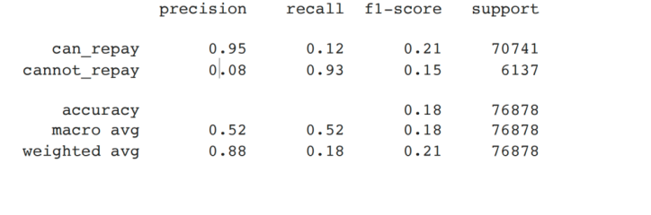
PERFORMANCE EVALUATION – NAÏVE BAYES MODEL
ACCURACY - The observed accuracy for the training data using naïve bayes model is 92.01%
The precision, recall and F1-score are –

Slide 22
MODEL SELECTION
Based on a few performance measurements, we compare the performance of all the models. The performance measurements used are - Accuracy, Recall, Precision and F1 Score.
We can infer from the table below that the RANDOM FOREST MODEL and LOGISTIC REGRESSION MODEL are the most accurate and effective models.
Although random forest produces results with a higher accuracy than logistic regression algorithm, we choose logistic regression model as the best option. This is so for:
The accuracy measure difference is negligible.
Because our data is made up of multiple data types, including int, float, and str, logistic regression works better.
Due to the vast amount of data, random forest implementation is very expensive.

Slide 23
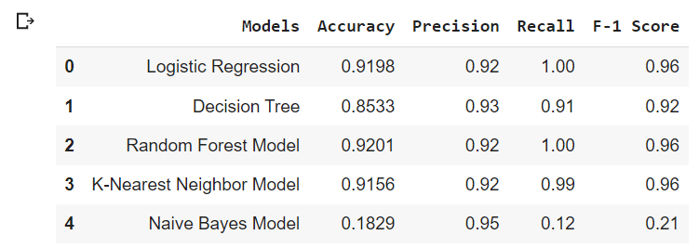
FINAL RESULTS

Slide 24
CONCLUSION
We investigated different machine learning algorithms and found that the logistic regression model fits our dataset the best. A common technique for forecasting continuous target variables based on one or more predictor variables is the logistic regression model.
A dataset with 307,511 observations and 241 features was used to train the model. By handling missing values, encoding categorical variables, and scaling numerical features, the features were preprocessed. The model was subsequently trained on a training set and assessed using a variety of metrics, such as mean squared error, R-squared, and adjusted R-squared, on a test set.
The final logistic regression model attained a recall score of 1 and an accuracy measure of 92%. These findings suggest that the model does a good job of classifying whether loan applicants will default or not.
However, it is important to note that the model has some limitations, such as the assumption of linearity and the presence of outliers or influential observations. Therefore, further analysis and refinement may be necessary to improve the models performance.

Slide 25
THANK YOU

